Slide 1
Tópicos Avançados em Bases de Dados
Trabalho realizado por:
Augusto Henriques - up201605486
João Monteiro - up201605221
João Silva - up201606816

Slide 2
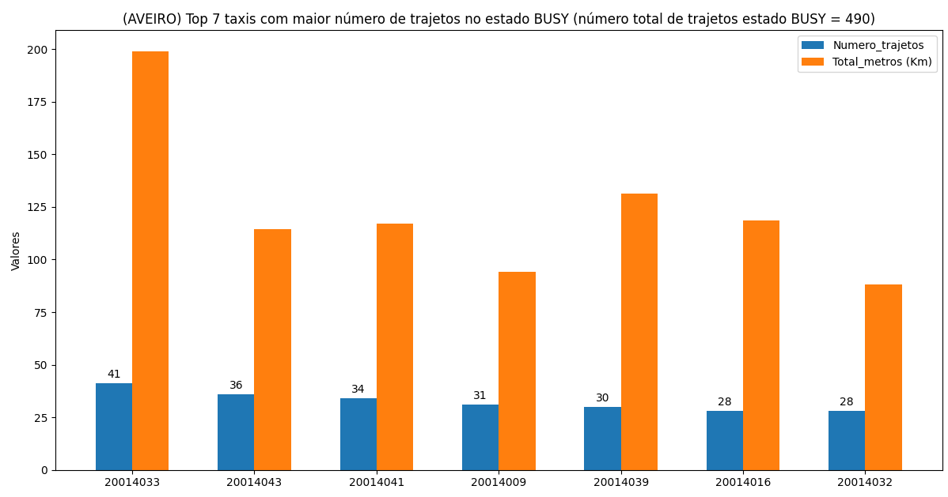

Slide 3
Query
select dw_taxi.taxi, dw_state.estado, sum(total_metros) as total_metros, sum(total_trajectos), sum(total_tempo) as tempo from dw_facts_table2, dw_taxi, dw_state, dw_tempo where dw_facts_table2.taxi_id=dw_taxi.id and dw_facts_table2.estado_id=dw_state.estado_id and dw_facts_table2.tempo_id = dw_tempo.tempo_id and estado = 'BUSY' group by rollup(1,2) order by 4 desc limit 15

Slide 4
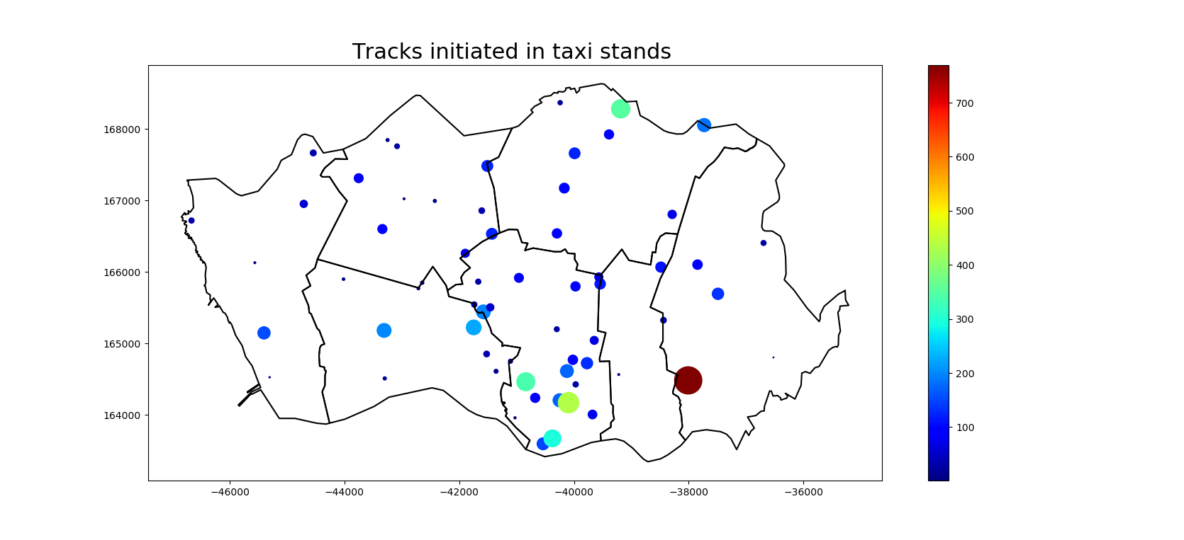

Slide 5
Query
select name, count(tracks.id), st_astext(proj_location) from tracks , taxi_stands where st_dwithin(proj_location, st_startpoint(proj_track), 50) group by name, proj_location;
select st_astext(st_envelope(st_collect(st_simplify(proj_boundary, 100, FALSE)))) from cont_aad_caop2018 where concelho='PORTO'
select st_astext(st_simplify(proj_boundary,10,False)) from cont_aad_caop2018 where concelho in ('PORTO');

Slide 6
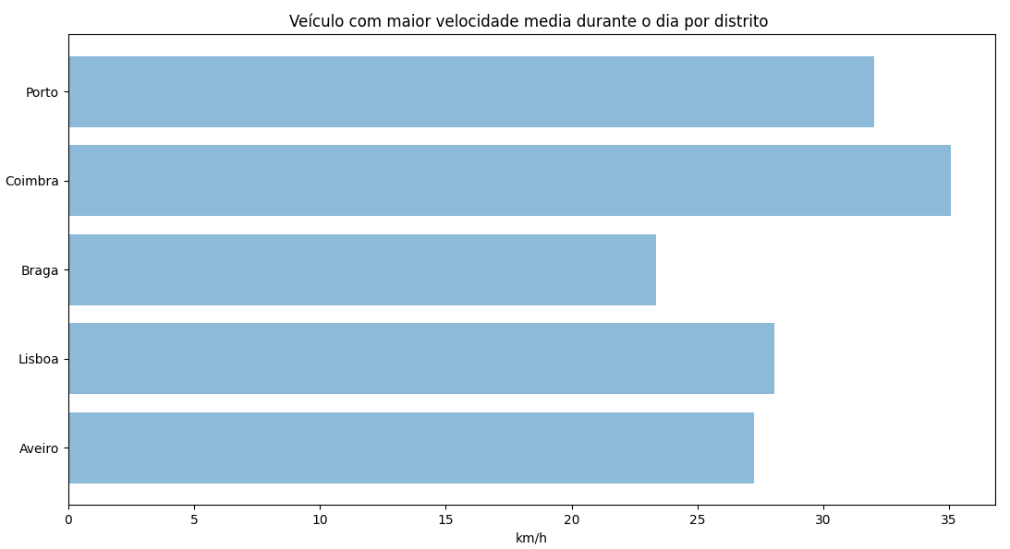
Veículo com maior velocidade média durante o dia por distrito

Slide 7
Query
select dw_all_taxi.taxi, dw_tempo.hora, sum(dw_facts_table3.total_metros) as total_metros, sum(total_trajectos) as total_trajetos from dw_facts_table3, dw_all_taxi, dw_state, dw_tempo where dw_facts_table3.taxi_id=dw_all_taxi.id and dw_facts_table3.estado_id=dw_state.estado_id and dw_facts_table3.tempo_id=dw_tempo.tempo_id and dw_all_taxi.taxi like '20014%' and dw_all_taxi.taxi like '20004%' and dw_all_taxi.taxi like '20007%' and dw_all_taxi.taxi like '20008%' and dw_all_taxi.taxi like '20000%' group by 1,2 order by 1,2 desc

Slide 8
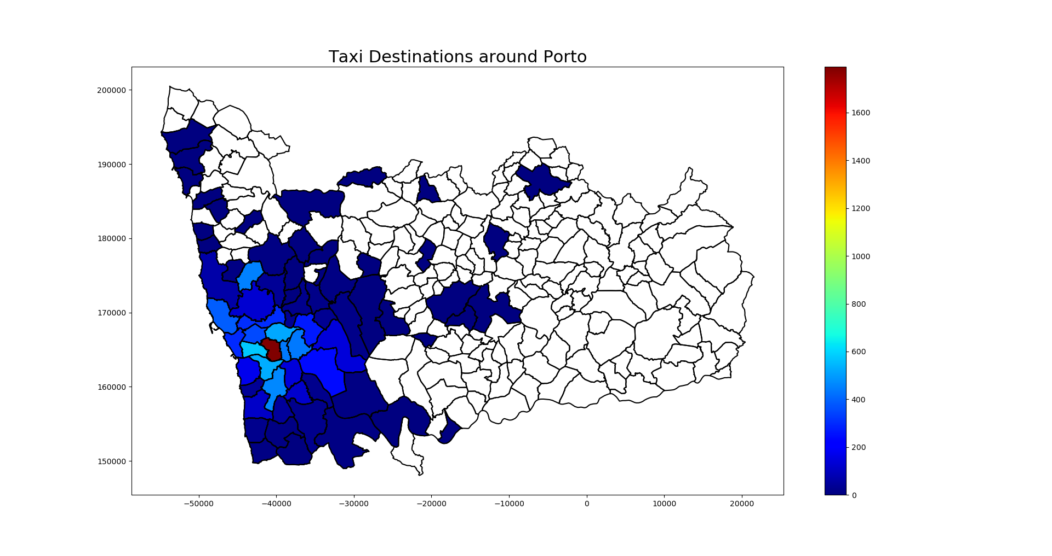

Slide 9
Query
select st_astext(st_simplify(proj_boundary,10,False)), count (id) as total from cont_aad_caop2018, tracks where st_intersects(proj_boundary, st_endpoint(proj_track)) and distrito= 'PORTO' and state='BUSY' group by 1;

Slide 10
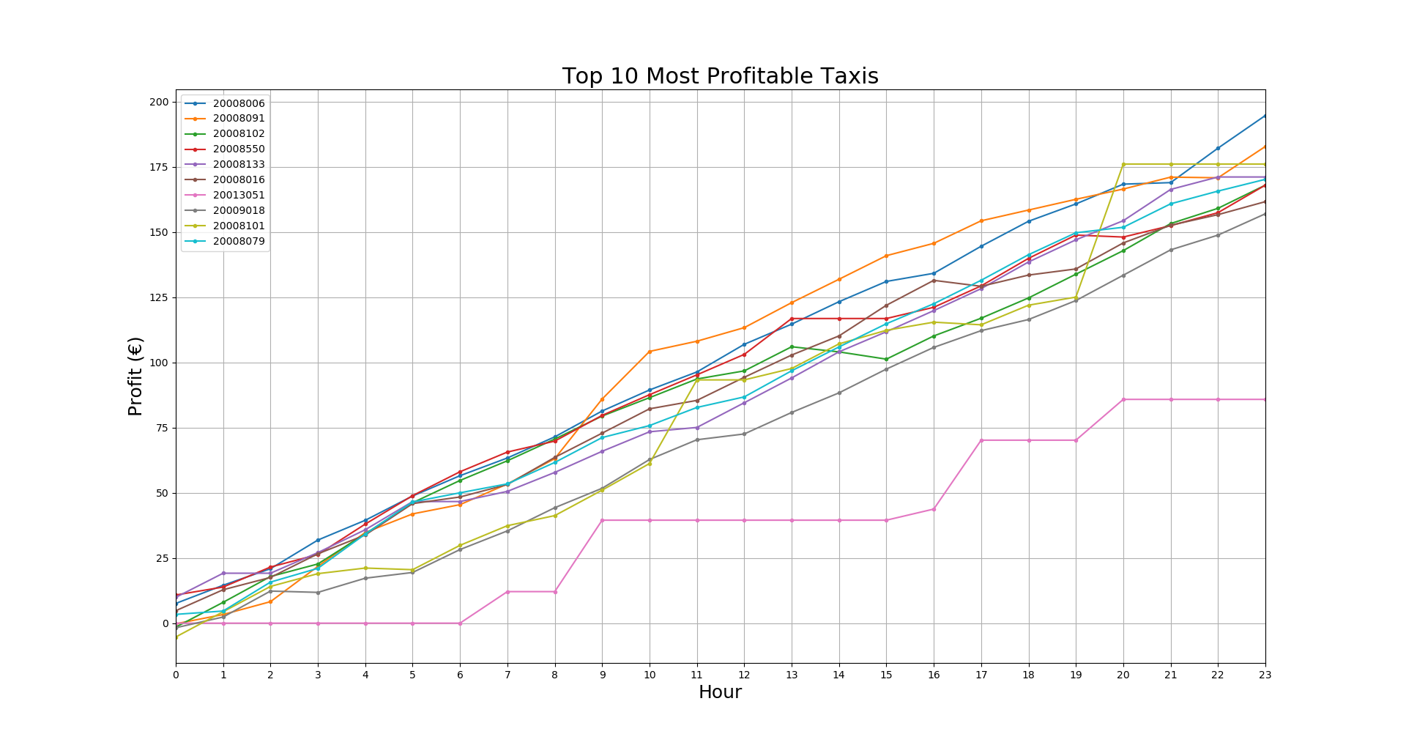

Slide 11
Query
select dw_all_taxi.taxi, dw_state.estado, sum(dw_facts_table3.total_metros) as total_metros, dw_facts_table3.tempo_id from dw_facts_table3, dw_all_taxi, dw_state where dw_facts_table3.taxi_id=dw_all_taxi.id and dw_facts_table3.estado_id=dw_state.estado_id and dw_all_taxi.taxi ='" + taxis[i] + "' group by 4,2,1 order by 4 asc;

Slide 12
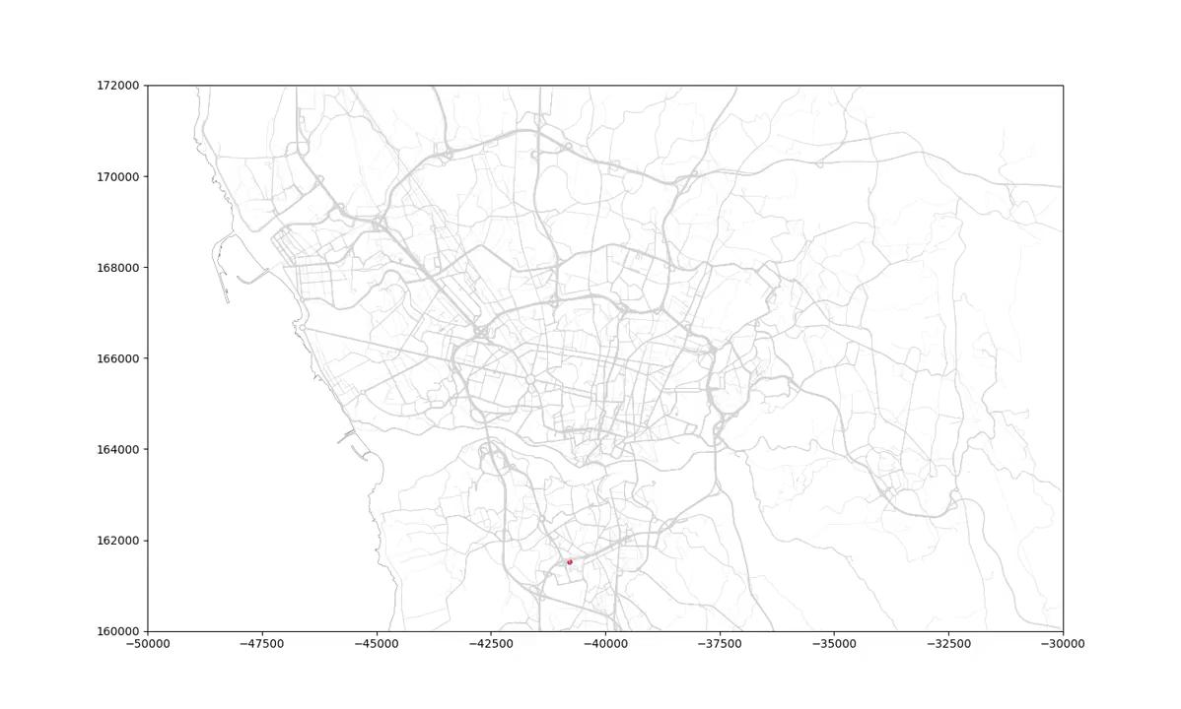

Slide 13
Query
select id, taxi, ST_Length(proj_track) from tracks where state='BUSY' order by 3 desc limit 1;
select st_astext(proj_track) from tracks where taxi='"+ str(taxi) + "' and id ='" + str(id) + "' order by ts"

Slide 14
FIM

